Slide 1
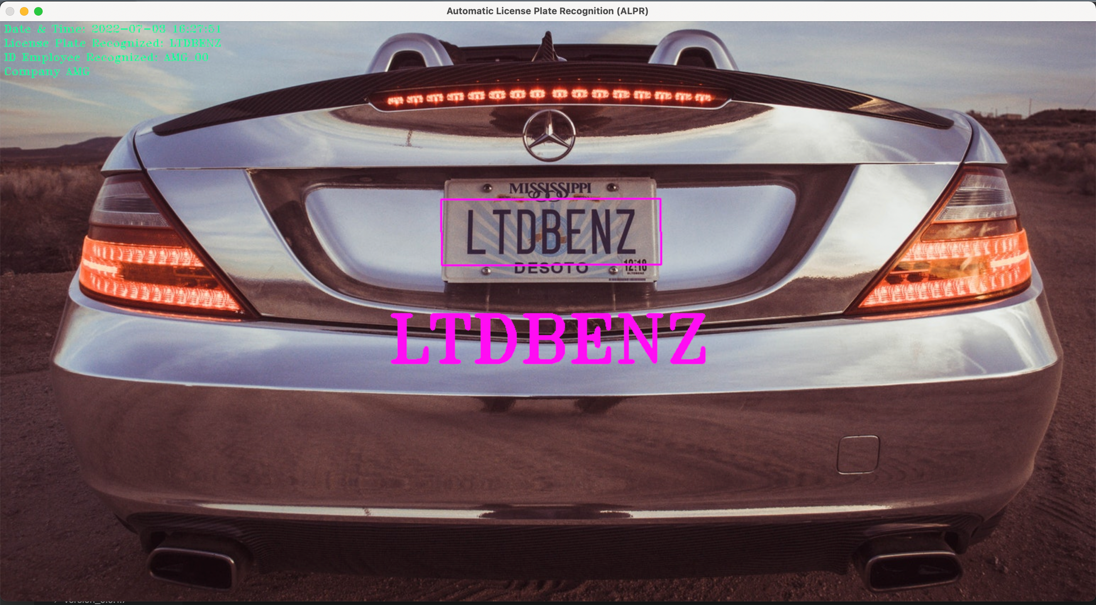
APPLIED COMPUTER SCIENCE & ARTIFIAL INTELLIGENCE: AI LAB PROJECT
ALESSIO
AUTOMATIC
PLATE
MARTINA
GIUSEPPINA
LICENSE
RECOGNITION

Slide 2
PROJECT CONTEXT
An Hypothetical AMG Company asked us to implement an ALPR System.
OBJECTIVE:
Automatization of AMG Employees’ License Plate Recognition through ML & DL Techniques.
OBJECTIVE(ADDITIONAL):
Query on the DATABASE to check for the Validity of the Employee.
Additional “AMG COMPANY ACCESS MANAGER”. Providing an Application Tool for the Control of the Accesses (Director’s Side).
Additional “AMG GATE INTERFACE”. Providing an Application Tool for the Employees Point of View when their car’s License Plate is being recognized.

Slide 3
MAIN OBJECTIVE
EMPLOYEEES’ ALPR
INTRODUCTION

Slide 4
OBJECTIVE 1: “AMG Employees’ ALPR” EMPLOYEEES’ ALPR INTRODUCTION
ALPR INPUT OPTIONS: (FRONTAL Point-Of-View)
We have three main Input Options in which we could apply our System:
Images provided in Input.
Pre-Registered Videos In Input.
Live-Videos in Input.
Note that, no matter what typology of input we give in input, the process is almost the same.
MAJOR DIFFERENCE: In Videos, we have to stop when we want to take the frame. (O’wise it takes the last frame).

Slide 5
ALPR PROCESS
01
02
03
PRE-PROCESSING STEP
From Original to Thresholded Image
LP DETECTION
Detection of the License Plate from the Thresholded image
LP RECOGNITION
Recognition of the Actual License Plate: CNN

Slide 6
MAIN OBJECTIVE
01
PRE-PROCESSING STEP

Slide 7
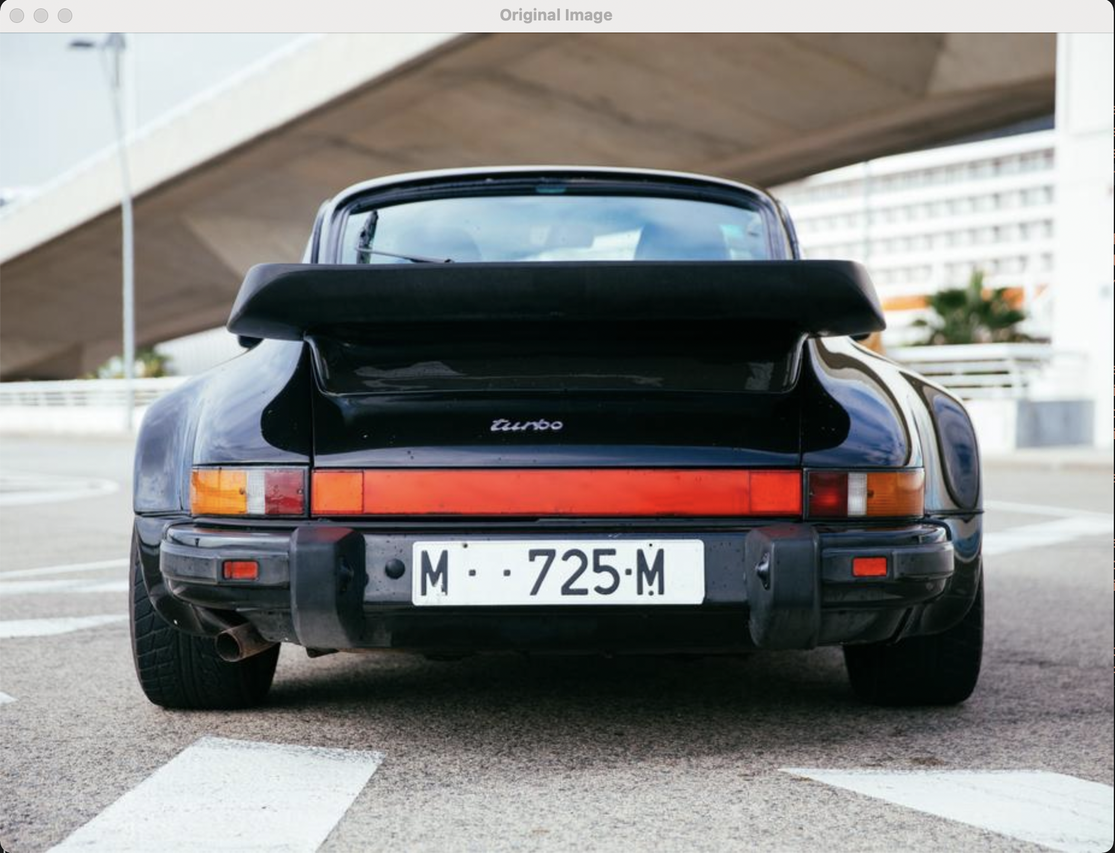
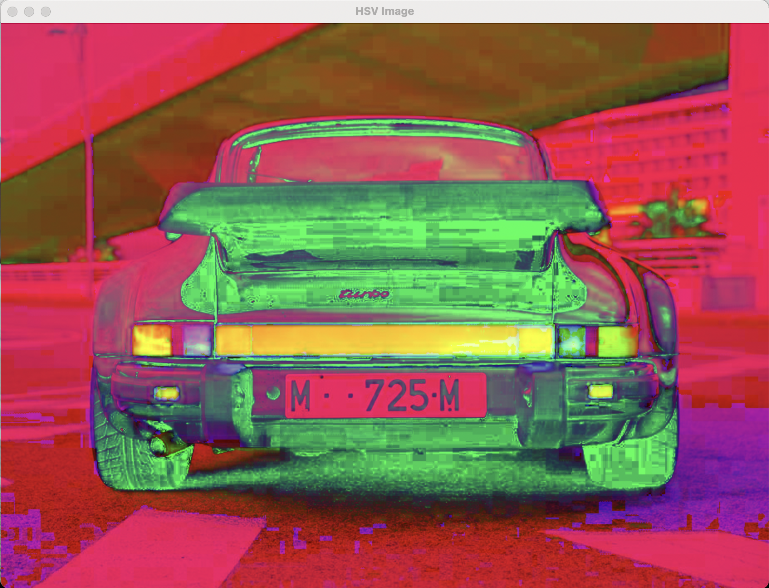
MAIN OBJECTIVE 1: “AMG Employees’ ALPR” STEP 1: “ PRE-PROCESSING”
The whole Process, that will see the Final License Plate to be outputted, provides a Pre-Processing Step in which:
INPUT: Frame (In both the 3 cases previously described).
OUTPUT: Thresholded Image.
RATIONALE:
Original Image: The frame received, is in the usual BGR Colour Space.
HSV Image: Changing the Colour Space from BGR -> HSV, in order to
separate image luminance from colour information.
(Remember that in the BGR Color Space it is not allowed to separate color
information from Luminance)

Slide 8
MAIN OBJECTIVE 1: “AMG Employees’ ALPR” STEP 1: “ PRE-PROCESSING”
Proceeding in Image Enhancing using several of the Morphological Transformations. We have converted images in Greyscale exactly for this, (Morphological Transformations are operations that are mostly applied on Binary Images). They allow to get rid of some noise, which can disturb the proper processing of our images.
TOP-HAT Transformation: In this way, we subtract from the Original Image the Open Image. Erosion will be used to eliminate smaller groups of undesirable pixels (like salt-and-pepper noise), affecting the regions of the image indiscriminately. By performing a Dilation, instead, we will reduce some of these effects.
Remember: TOP-HAT = Original Image – Open Image,
where:
Open Image = Erosion + Dilation

Slide 9
MAIN OBJECTIVE 1: “AMG Employees’ ALPR” STEP 1: “ PRE-PROCESSING”
BLACK-HAT Transformation: In this way, we subtract to the Original Image the Closing Image. Here, we perform the opposite operation of before, namely, first perform the operation of Dilation, followed by an Erosion. This is commonly used for filling small holes in images.
Remember: BLACK-HAT = Original Image – Closing Image,
where:
Closing Image = Dilation + Erosion

Slide 10
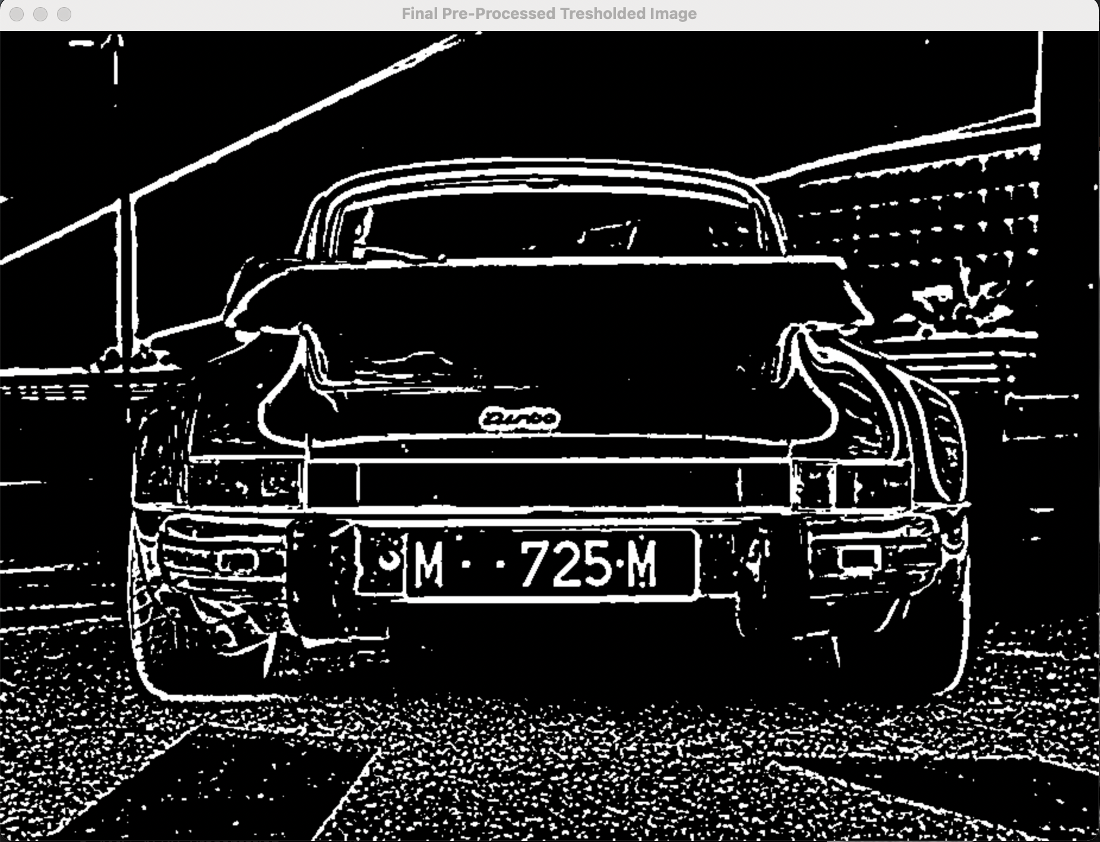
MAIN OBJECTIVE 1: “AMG Employees’ ALPR” STEP 1: “ PRE-PROCESSING”
We then proceed in the De-Noising Process, the last step for
Pre-Processing Step 0.
Gaussian Blur: We then proceeded by applying Gaussian Blur
which is highly effective in removing Gaussian noise from the image.
Adaptive Thresholding: Here, since an image, in most of the cases, has
different lighting conditions in different areas. Threshold determined w.r.t. the
ROI around it.
(w.r.t. the Simple Thresholding, in which for every pixel, the same threshold value
Is applied).

Slide 11
MAIN OBJECTIVE
02

Slide 12

MAIN OBJECTIVE 1: “AMG Employees’ ALPR” STEP 2: “ LP DETECTION”
INPUT: Thresholded Image.
OUTPUT: Candidate Licence Plates.
DEFINITIONS:
Candidate Character: It is defined to be a Contour that is Alpha-Numeric Shaped.
Candidate License Plate: It is defined as a set of Candidate Character that have a Pythagorean Distance and an Angle between the Characters that is License-Plate-wise.
In our image, indeed, we can have a lot of shape that are Characters-wise. We proceed as first thing in:
Candidate Characters Extrapolation: Extrapolation of a list of Candidate Characters (Contours) in the Image. -Contour detection -Valid shape check (we check proportions and compare them to some empirical thresholds)

Slide 13




MAIN OBJECTIVE 1: “AMG Employees’ ALPR” STEP 2: “ LP DETECTION”
2. Candidate License Plate Formation: Starting with the Big-List of Candidate Characters, perform a Brute- Force comparison to check the Pythagorean Distance and Angle between Characters. The Pythagorean Distance (between the COMs) guarantees that the characters are not too far away from each other, hence they belong one plate. The Trigometric distance (between the COMMs) guarantees that characters are aligned. Those checks are performed between all couples of charcters, and dive as a result the list of aligned charcters, that constitute possible plates

Slide 14
MAIN OBJECTIVE 1: “AMG Employees’ ALPR” STEP 2: “ LP DETECTION”
Eliminating Overlapping Characters: We perform an ulterior screening in the list of Candidate License Plates. Indeed, it can happened that some of the Contours that have been detected, are doubled. We proceed in deleting overlapping characters from the list of Matching Characters. Whenever we have two characters that are either overlapping or are too close to each other to possibly be separate chars, we remove the Smaller Character.
As an example, we had that for the letter 'O' both the upper and below part of the "ring" may be found as two distinct characters, while for us, we should only once.
License Plate Extraction: We can then proceed by performing the true Plate Extraction, namely, given the Candidate License Plate, we are going to extract from the Original Image the Cropped Image of the License Plate. Then, perform all the Pre-Processing also on the Candidate License Plate Extracted.

Slide 15
MAIN OBJECTIVE
03

Slide 16
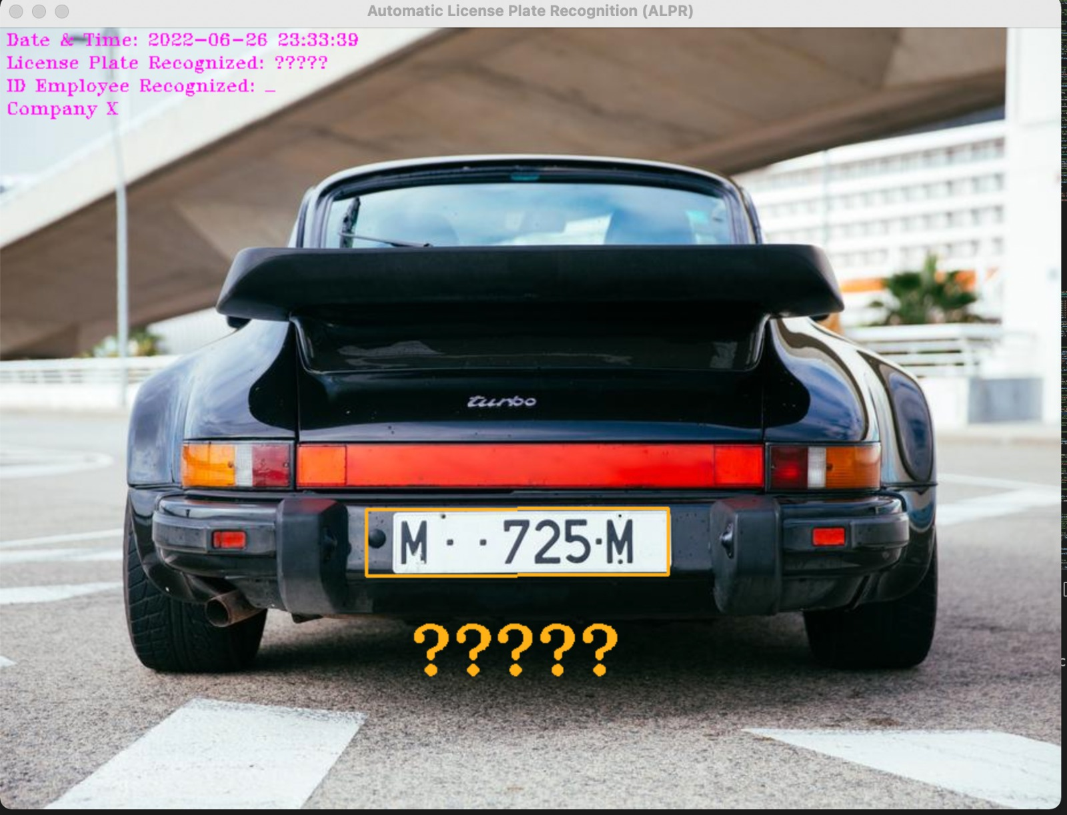
MAIN OBJECTIVE 1: “AMG Employees’ ALPR” STEP 3: “ LP RECOGNITION”
Actual License Plate Recognition: This is the step from which we get back the String given in input the Set of Candidate License Plates. We crop the characters (Creation of a ROI), add some padding, resize the image to the same dimension of Training Samples (28x28) and pass to the Recognition Algorithm.
KNN(K-Nearest-Neighbour): We first tried to use a ML Algorithm, implementing a 1-NN. However, it was a Miserable Failure. The result we obtained, indeed was:
REASONS:
KNN is a ML that is very strict in its Classification. Thus, if
we provide an image that is slightly different from the ones
on which the algorithm has been trained, this will result in a
wrong classification for sure.
SOLUTION:
Use a CNN!

Slide 17

MAIN OBJECTIVE 1: “AMG Employees’ ALPR” STEP 3: “ LP RECOGNITION”
CNN IMPLEMENTATION:
For the CNN Implementation, we performed several tries, changing: -number of convolutional layers -number of fully connected layers -activation function -loss function -number of epochs for the training
CNN FINAL FORM After many trial we decide to build our model as a simple 2 Level CNN, using MISH as activation function and the CrossEntropyLoss (Indicated for Multiclassification, as in our case), as Loss Function. We started the training with low epochs and we reached a maximum of 100 epochs.

Slide 18
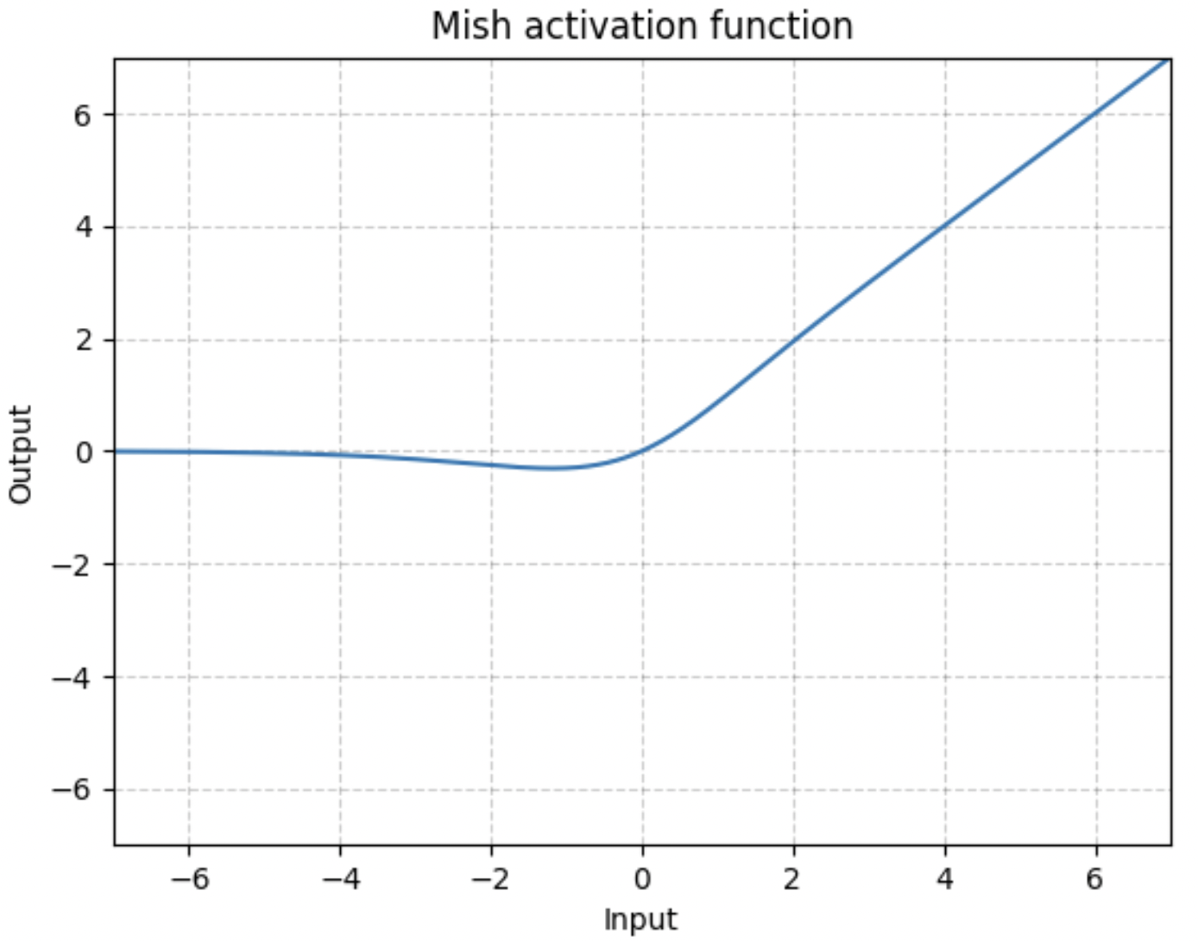
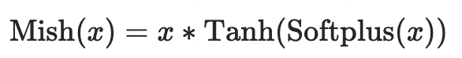
MAIN OBJECTIVE 1: “AMG Employees’ ALPR” STEP 3: “ LP RECOGNITION”
CLOSE UP ON ACTIVATION FUNCTIONS: During the several tries, we started with a ReLU Activation Function, then we tried with the LeakyReLU, having a significant increase. At the end, after advice from the Professor, we tried the new-entry Activation Function MISH, that was proposed in 2019 by the Cornell University, that performs better at a lower learning rate than any other Activation Function.

Slide 19
MAIN OBJECTIVE 1: “AMG Employees’ ALPR” STEP 3: “ LP RECOGNITION”
During our training we focused on reaching the bet performance we could in terms of accuracy. We played with previously mentioned features and we sampled from the dataset in a balnced way in order to be sure to train on a even number of samples per character.
We reached also a good accuracy, with a Peak of 95.628%. However, it was too specific (Overfitting), thus we opted for choosing other CNN Implementation that has an Accuracy of about 91%.

Slide 20
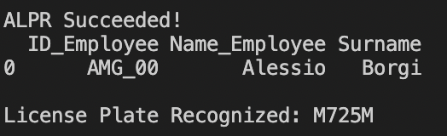
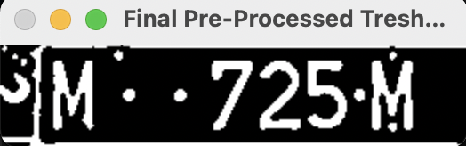
MAIN OBJECTIVE 1: “AMG Employees’ ALPR” STEP 3: “ LP RECOGNITION”
After the Recognition of all the Candidate Licence Plates, we find the Final Licence Plate by doing a Greedy Choice, that is the one to choose the Longest-Recognized-Characters License Plate, that we assume to be the actual license plate. At this point the string value of the plate is stored and ready to be used to retrieve information about the car owner.

Slide 21
MAIN OBJECTIVE 1: “AMG Employees’ ALPR” STEP 3: “ LP RECOGNITION”
DATASET:
As Dataset, we had initially opted for the EMNIST Dataset, but due to the fact that it is based on handwritten alpha-numeric character, and due to its huge dimension, that made the training unfeasible we opted for a more standardized Dataset:
Standard alpha-numeric characters.
Labels as the folder’s name.
36578 samples, 1016 for each of the 36 classes.

Slide 22

MAIN OBJECTIVE 1: “AMG Employees’ ALPR” STEP 3: “ LP RECOGNITION”
SAMPLING FROM THE DATASET:
However, provided that we have done this choice of opting for a Customized Dataset, we had to handle the creation of a Customized Dataset (for sure the more painful part of the project).
We therefore had to do the Balanced Train-Test split by-hand.

Slide 23
ADDITIONAL OBJECTIVES
a
b
c
LP DATABASE: VALIDITY CHECK
Check whether the LP is Authorized or not
AMG Company Access Manager
Director’s Point of View
AMG Gate Interface
Employee Point of View

Slide 24
ADDITIONAL OBJECTIVE
a

Slide 25

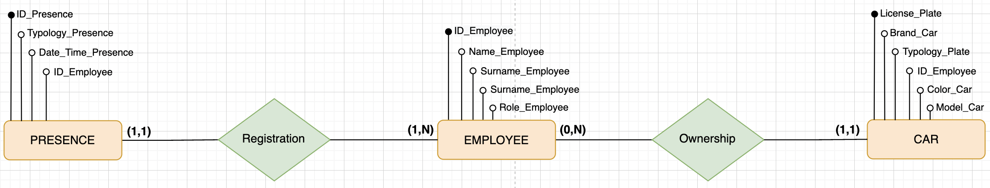
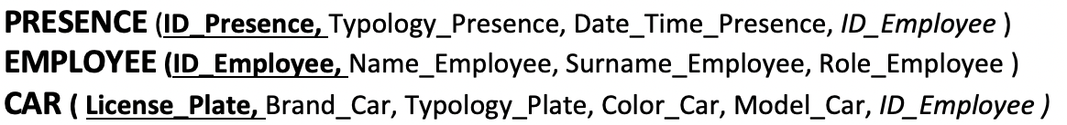
ADDITIONAL OBJECTIVE a: “LP DATABASE: VALIDITY CHECK”
DATABASE QUERY:
Once that we have the Final License String, we will have to see whether it is one of the Employees or External people that is Authorized to access in the Company, or whether it is not.
For this reason, we built up a very simple Database that will handle this task.
ER-SCHEMA
LOGIC SCHEMA
POSTGRES IMPLEMENTATION

Slide 26
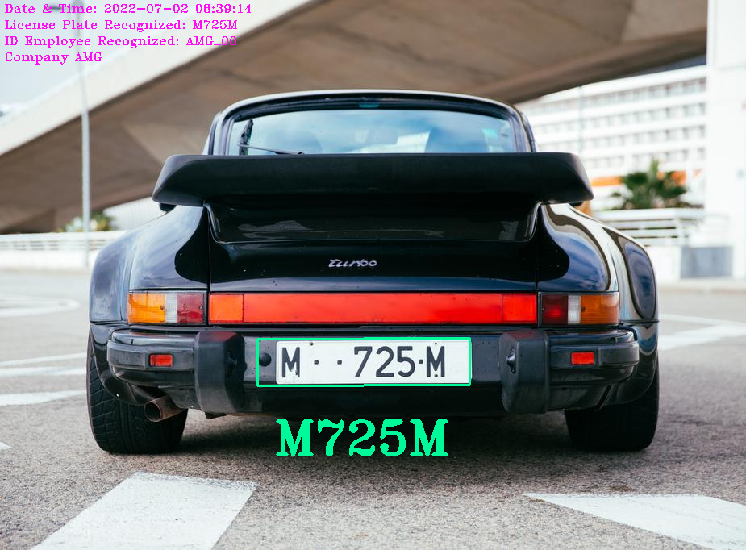


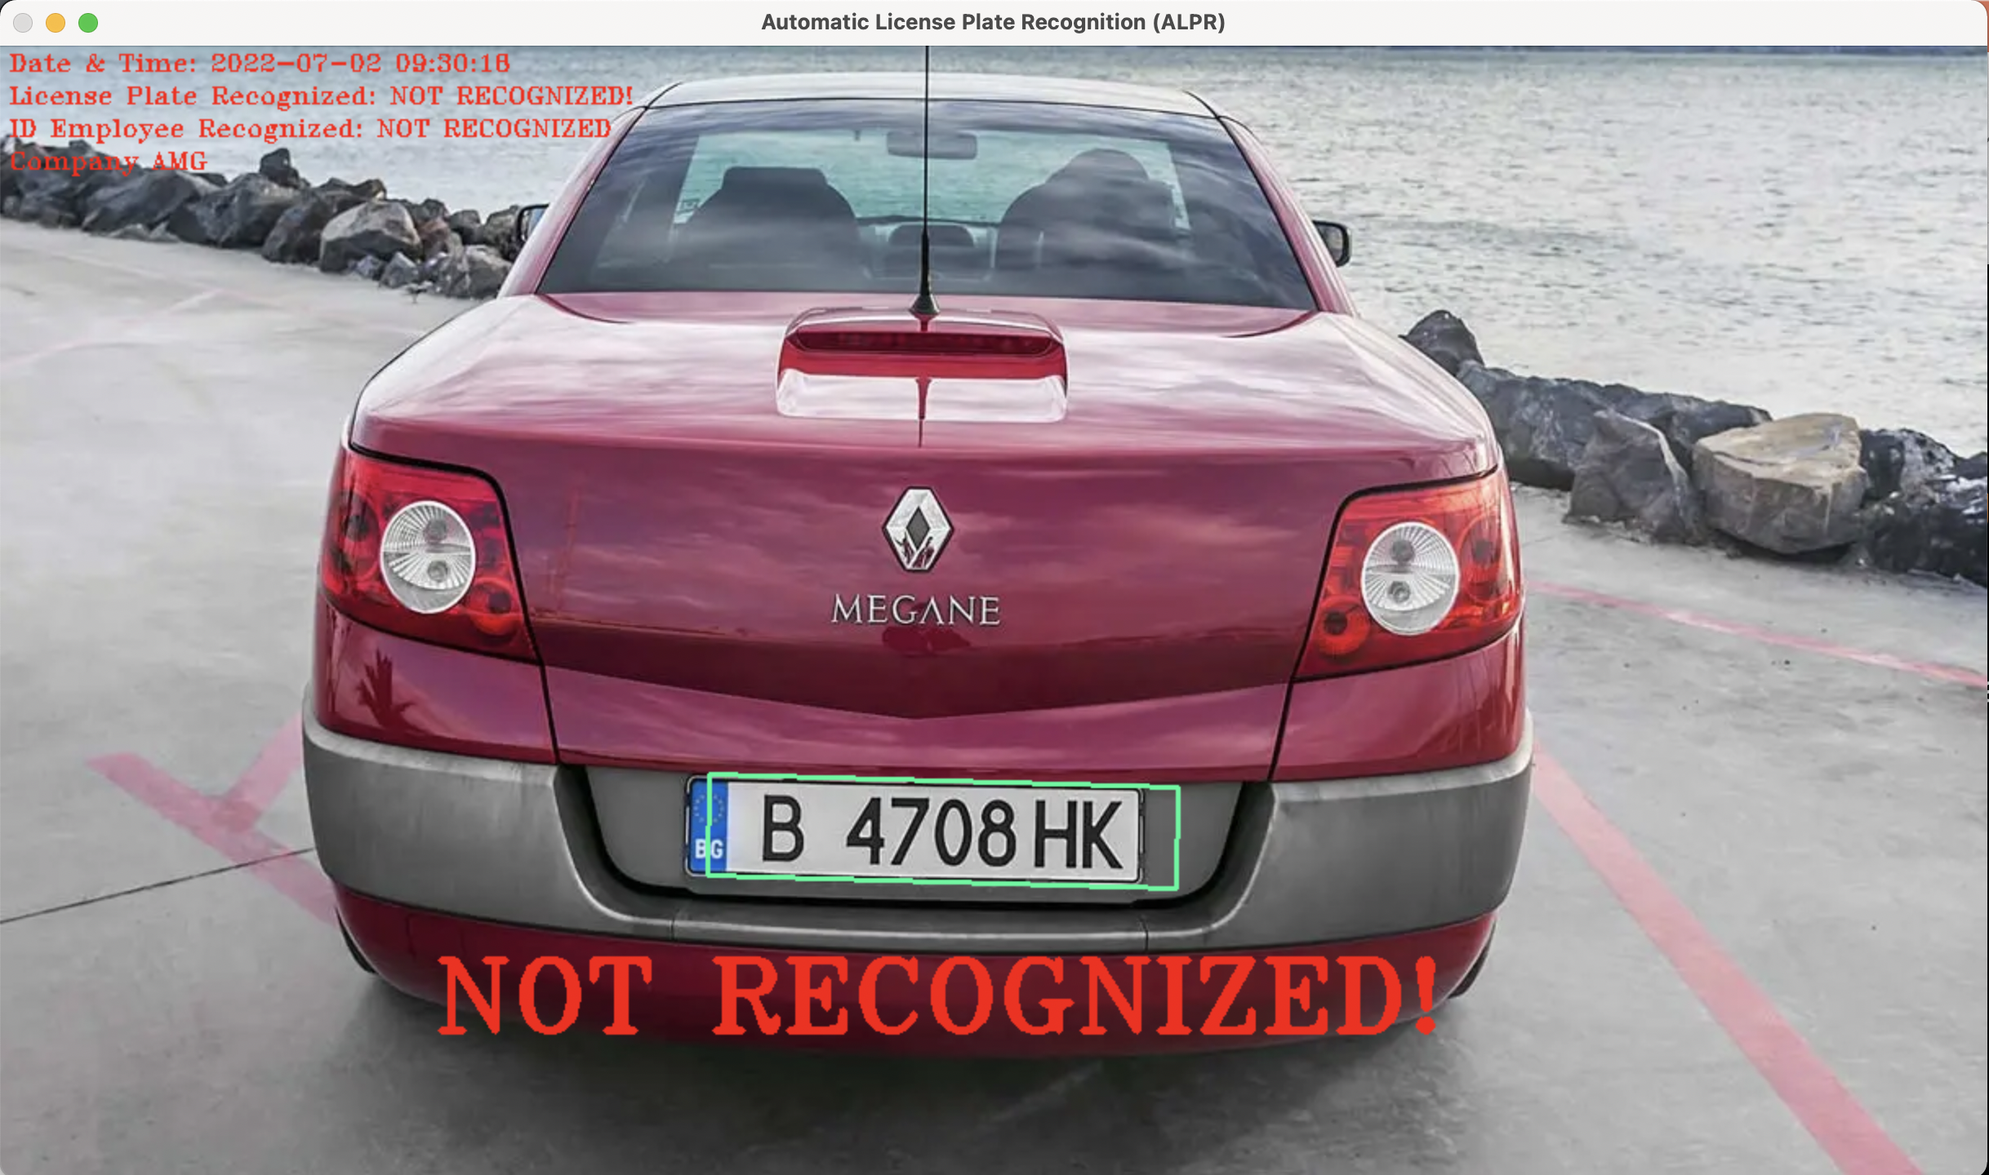

ADDITIONAL OBJECTIVE a: “LP DATABASE: VALIDITY CHECK”
VALIDATION PROCESS:
LP String
(Ex. “M725M”)
(Query)
Not Properly Recognized Not Authorized

Slide 27
ADDITIONAL OBJECTIVE
b

Slide 28
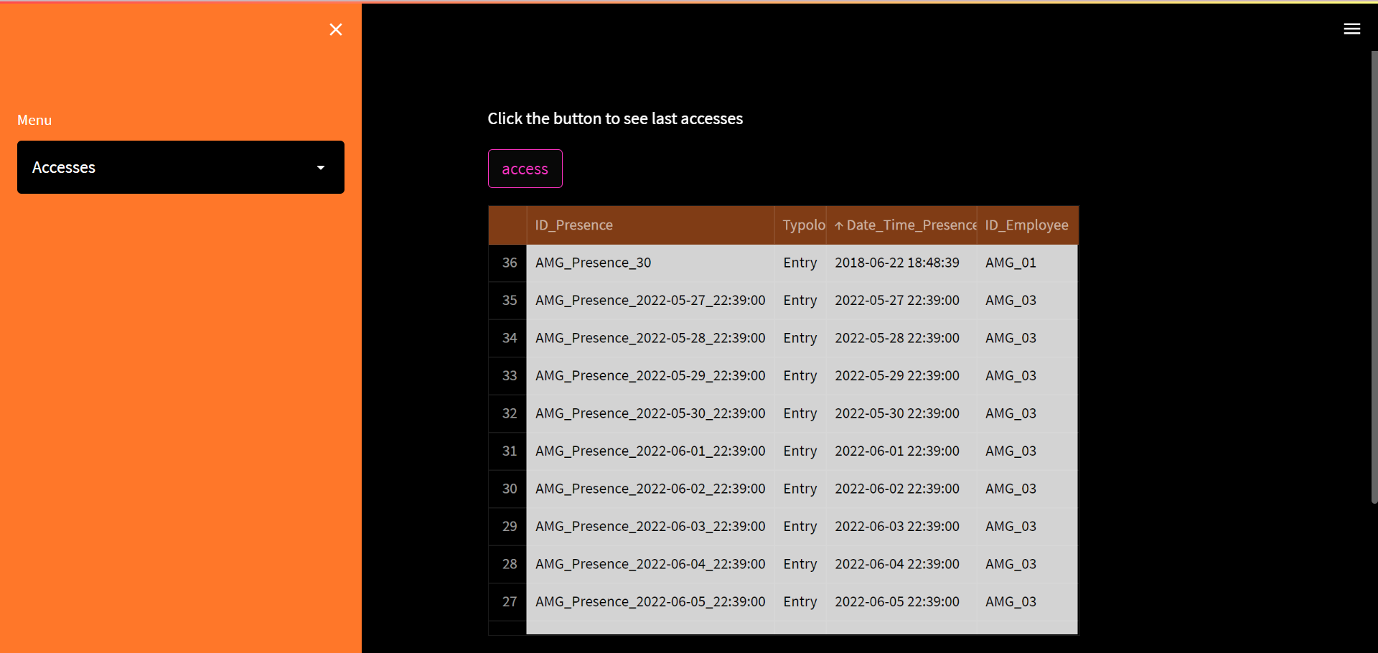
ADDITIONAL OBJECTIVE b: “AMG COMPANY ACCESS MANAGER”
We decided also to add some new Additional Tools to the Project. The first one we have added is the Company Access Manager that is an Application GUI in which we wanted to describe also the Director’s Side of the System.
It’s a for page web applications that allows to: -view the valid place for the company -view a list of all the accesess that can be refreshed at any point to display update

Slide 29
ADDITIONAL OBJECTIVE
c

Slide 30
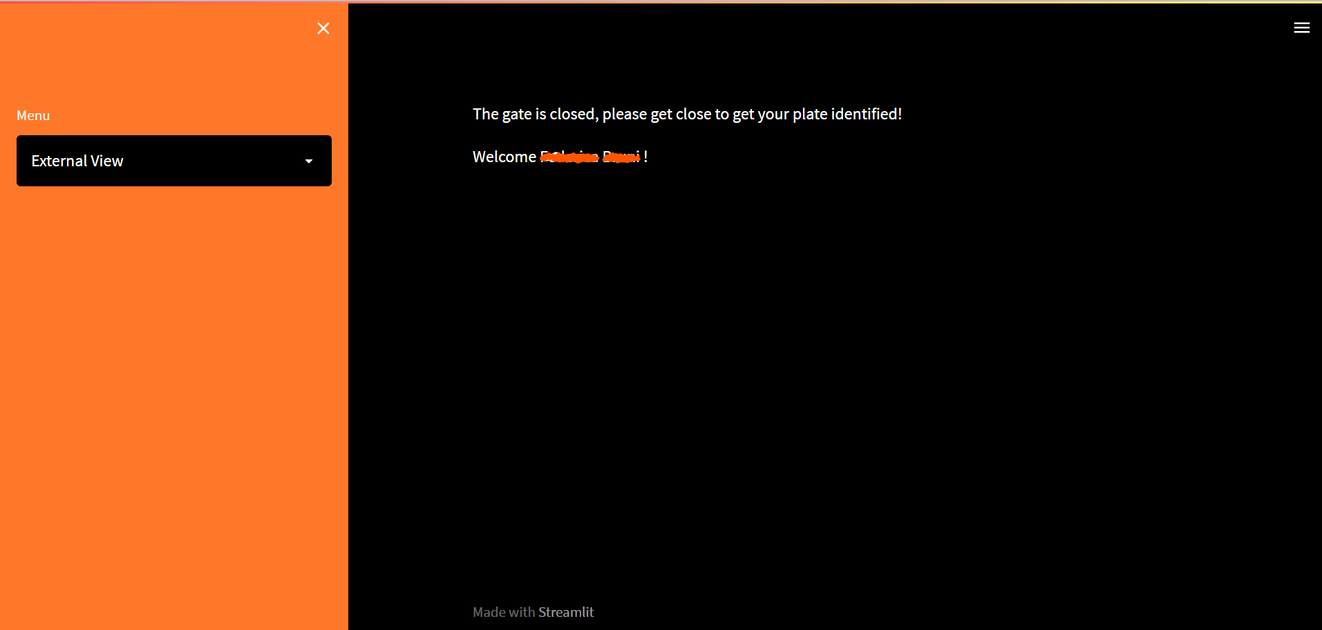
ADDITIONAL OBJECTIVE c: “AMG GATE INTERFACE”
The second Additional Tools we have added to the Project, inside the Web Application, is the “AMG Gate Interface”, through which we wanted to represent what is the Employees Point of View when their car’s License Plate is being recognized. It’s a page that is updated automatically when a plate recognition is successfully executed.

Slide 31

THANKS!
ALESSIO BORGI
MARTINA DOKU
GIUSEPPINA IANNOTTI
dsfsfsdf

